Slide 1
Digital Showcase
School of Languages, Cultures and Societies

Slide 2
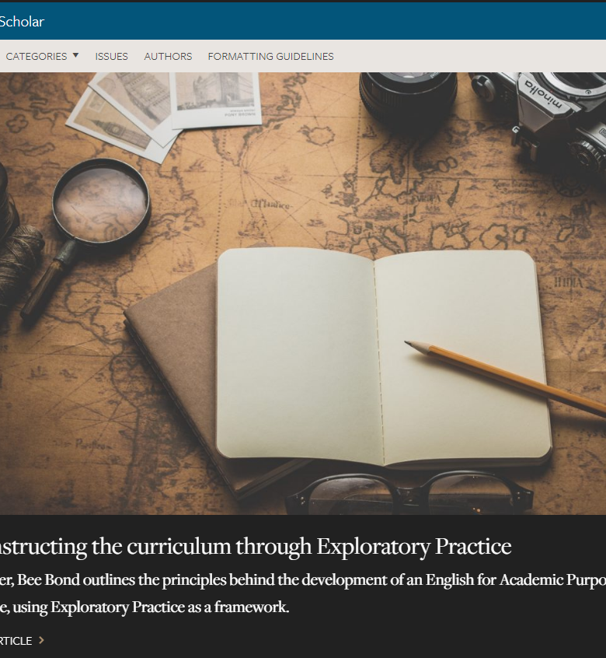
Centre for Excellence in Language Teaching (CELT)
Dr. Alex Ding
The Language Scholar
an open access peer-reviewed journal
a platform to promote the scholarship of learning and teaching languages
www.languagescholar.leeds.ac.uk

Slide 3
The Language Scholar Special Edition
Digital Technology
Deadline: 29th March 2019
Submission and formatting guidelines available at https://languagescholar.leeds.ac.uk/

