Slide 1
Languages for All (LfA)
The Italian Digital Project
Patrizia Lavizani: p.lavizani@leeds.ac.uk

Slide 2
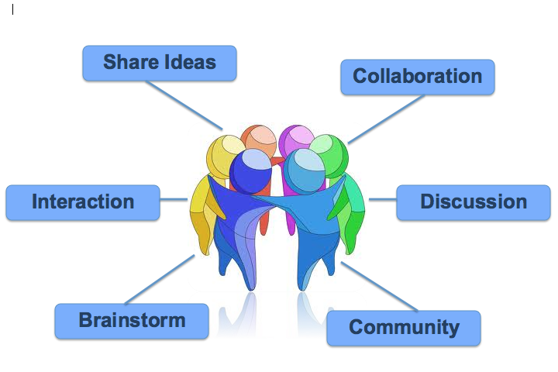
In this presentation…
What do they say?
Idea…
Hope…

Slide 3
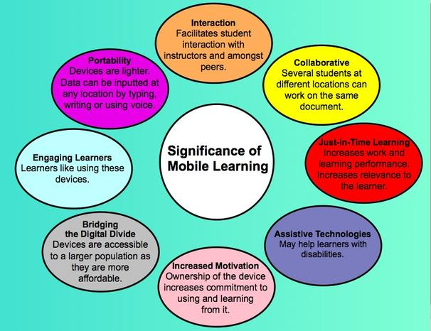
What we know…
Technology and Digital Learning..

Slide 4
Research
- Learning theories (connectivism – fairly recent)
- Technology for interaction and collaborative work as well as a motivational tool
- Inclusive practice: disability and diversity
- Assessment and feedback
Virtual learning environments supporting mobile learning and accessibility.
Useful readings:
When technology offers an helping hand…
Kate Exely, Andy Fisher, Dragos Ciobanu, (2014). Using Technology to Support Learning and Teaching. Routledge – Taylor and Francis group- London and New York
Technology benefit those who use it as a pedagogical vehicle of productive tasks…
M. Evans, (2009). Foreign Language Learning with Digital technology. In Elodie Vialleton, Language Learning and Technology Volume 16, Number 2 pp. 27–30. June 2012. Retrieved on 18.11.16 from: http://llt.msu.edu/issues/june2012/review1.pdf

Slide 5
The Italian Digital Project
The Italian Digital Project = beginners and elementary modules’ aims
Develop awareness of culture
Benefit from language learning and derive enjoyment
Enhance the student experience, facilitate travel, work and study abroad
Enhance students’ employability
Develop communication skills, initiative, independent learning, team work and time
management
https://uolandiamoinitalia.wordpress.com//

Slide 6
Pros and Cons and students’ opinions
Pros -on-line research materials for cultural awareness and digital tools to create and present own learning –sharing information/work independence and peer learning increased student motivation, creativity time management, organisation, team work, employability ‘real life’ situation, using the language for a purpose, deep learning reflections: greater insight into students’ thinking positive impact on both teaching and student learning possible… more comprehensive approach to assessing: process and product Students opinion: Italian Website Feedback ‘I thought it would be a nice thing to have in the future to show to employers who might question language skills’ | Cons students confused about what its purpose is how long it should be, how much in depth to go … time required to explain it…. extra tutor time (workshops) tutors commitment to engage with digital tools lack of interest not assessed! Student opinion: ‘I think it would have been highly beneficial if we used the digital project as a form of assessment because it shows a continuous commitment to work instead of a portfolio which was a bit synthetic in terms of structure and other things’.

Slide 7
hope: opportunities and challenges…
to inspire other tutors to use a digital platform with their students
to adopt the digital project idea as part of the assessment process in LfA from beginners to advanced levels
to collaborate with other tutors in the School of Languages, Cultures and Societies at Leeds and other Universities interested
to use the idea for other projects in a variety of fields, i.e. study abroad students, content related modules, final year projects…

Slide 8
Worthwhile?
Important:
to discuss and reflect on the experiences of using technology and digital tools for learning and
to share ideas across the language teaching community to learn and research the field further
to support tutors in using technology and digital tools in their teaching
to acknowledge the effort and time needed by tutors… in the workload
University of Leeds strategic plan:
‘Define and implement sustainable support for
digital learning’
https://www.google.co.uk/url?sa=t&rct=j&q=&esrc=s&source=web&cd=4&ved=0ahUKEwiJzpX18vPQAhWEIcAKHZaiC_EQFggxMAM&url=https%3A%2F%2Fwww.leeds.ac.uk%2Fdownload%2F76%2Fstrategic_plan_2015&usg=AFQjCNEUpqts_77vIg9cmSKqa05-AUe4QQ&bvm=bv.141320020,d.ZGg

Slide 9
Languages for All
Any questions ?
Grazie tante !
Thank you !

