Slide 1
Poll Everywhere
LCS Digital Showcase
James Moore

Slide 2
Please take my survey during the presentation
PollEv.com/surveys/nmkPjulZk

Slide 3
GE Needs Analysis
PollEv.com/surveys/nmkPjulZk

Slide 6
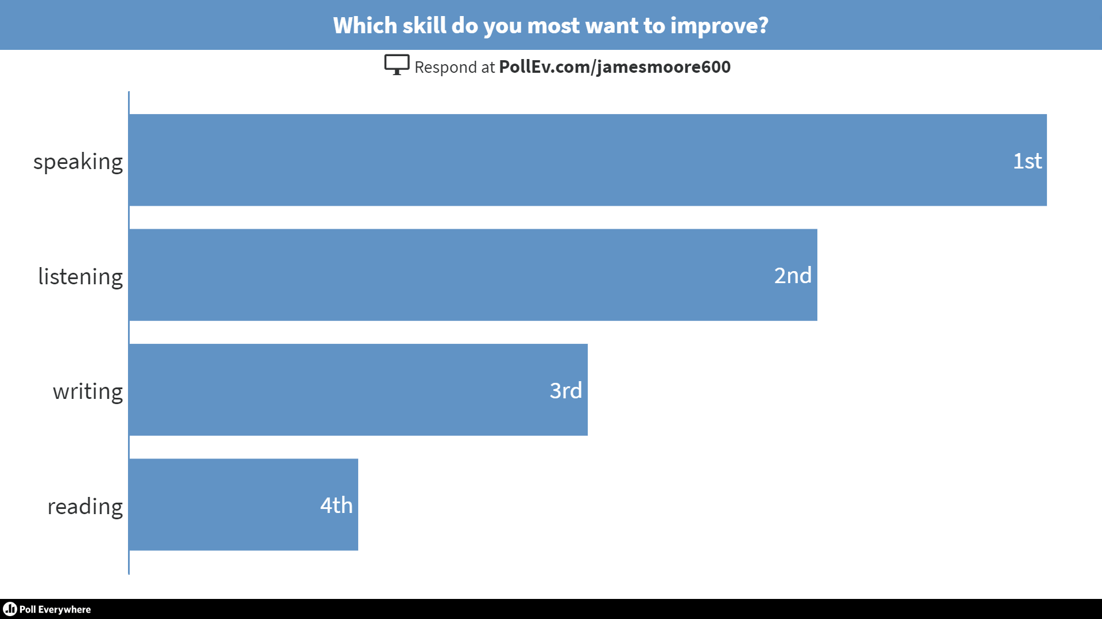

Slide 7
Other uses:
Trips
Options classes

Slide 8
Benefits
Free
Question type variety
Quick to use
Instant results
Respondents don’t need an account

Slide 9
Limitations
Some aspects not user-friendly
Max. 40 respondents
Sending results
Can’t see all results until everyone has finished
https://www.polleverywhere.com/my/polls

Slide 10
Happy polling!

