Slide 1
A couple of smartboard hacks and one very student (and teacher!)-friendly application….
Technology Enhanced Teaching

Slide 2
For the next 5 minutes:
Time management and respect for other colleagues is important to me; hence me setting a 5 minute alarm.
These hacks may be very obvious to you…so I’m sorry if that’s the case!
I am fairly sure that you probably haven’t used the application I am about to show you…I hope that you might find it useful in the classroom.

Slide 3
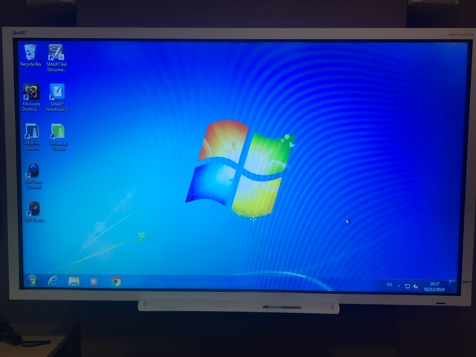
Smart board hack 1:
Help! I can see there is a smartboard in my room but I can’t use the pens!
Try:

Slide 4
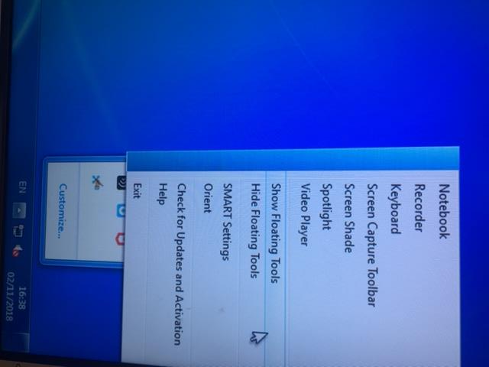
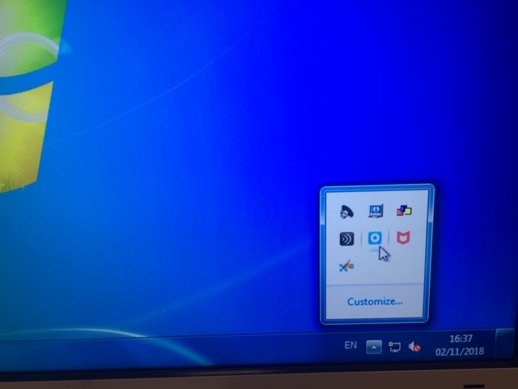
Smart board hack 1:

Slide 5
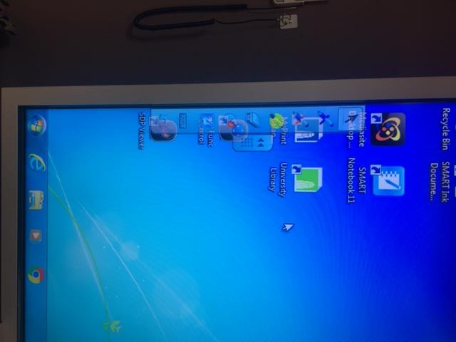
Smart board hack 1…et voilà. You now have ‘floating tools’.

Slide 6
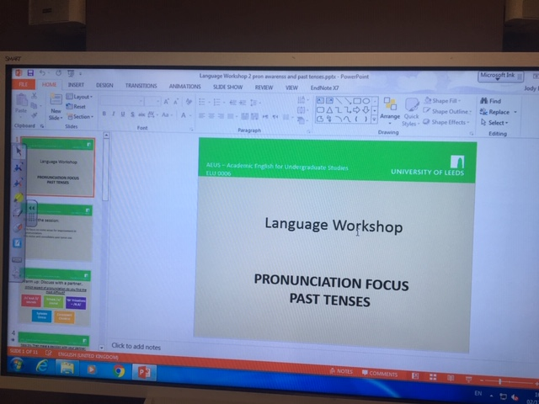
Smart board hack 2:
Help! I want to write on my ppt or word document, but the writing DOESN’T MOVE with the document when I scroll up – it stays fixed!
Try:

Slide 7
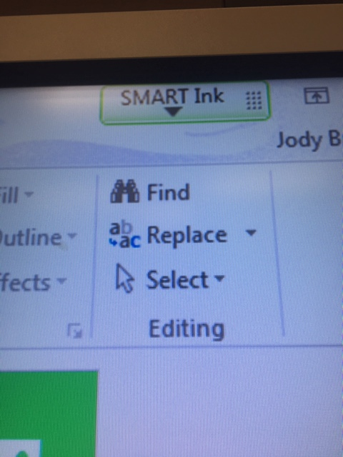
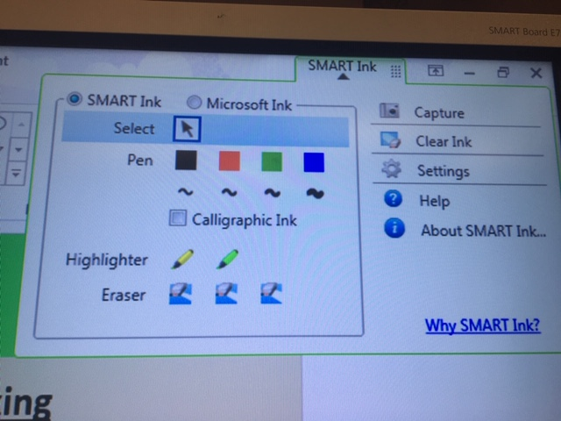
Smart board hack 2:

Slide 8
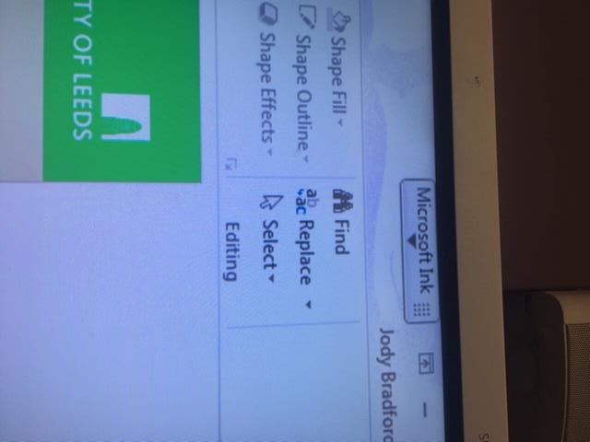
Smart board hack 2…et voilà. You are now able to write on the document, as opposed to the screen..

Slide 9
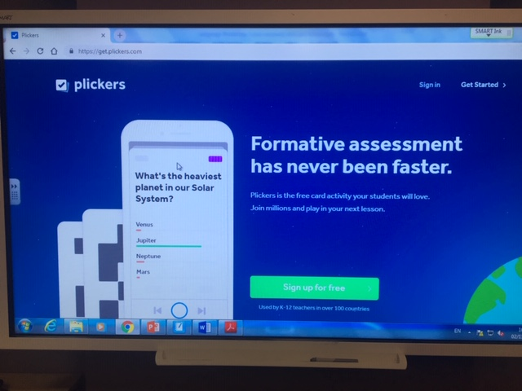
Second subject for today: An application called ‘Plickers’:

Slide 10
https://www.plickers.com/library
Let’s have a go at Plickers!
12 volunteers please. Or I may nominate.
Time is of the essence! Only 2 minutes left…

