Slide 1
The evolution of technology in enhancing Japanese script acquisition
Christopher Lacey

Slide 2
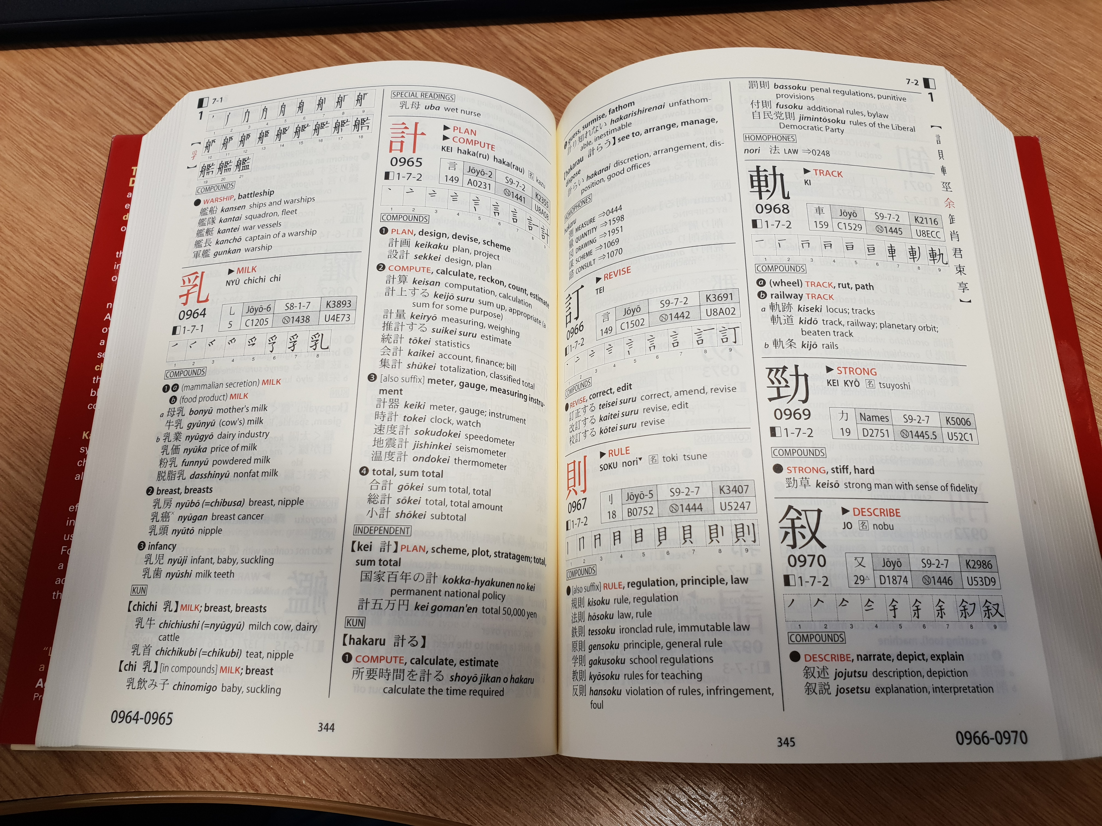
Old school learning – hard slog
Requirement to count strokes for each character
Time consuming
Different systems in different dictionaries/resources
Difficult language feels overwhelming for many

Slide 3
Website interactivity – mouse + interface
Can write the character with your mouse
Select correct option
Need to write characters neatly and in correct order
Stroke order animations
Somewhat clumsy to write with a mouse
https://jisho.org/

Slide 4
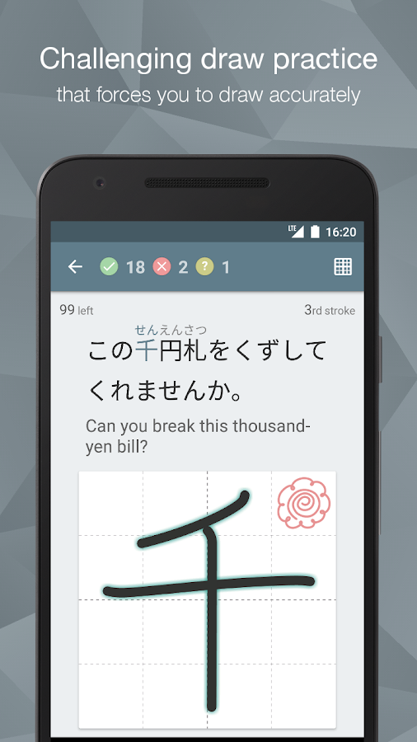
Kanji Study – pay app
Writing practice via the touchscreen using your finger
App corrects you – indicating if a stroke is in the wrong place, at the wrong angle etc.
Flashcard-style system
Can track accuracy of sets or individual characters over time
Incentive to repeat/reminders

Slide 5
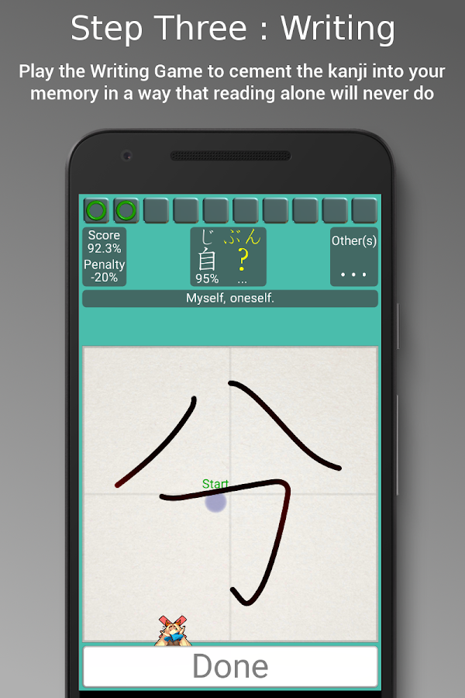
Kanji Tree
Free app
Gives you a % accuracy score
Incredibly strict!
Kanji divided into both order of learning in Japanese schools and order of appearance in different levels of the Japanese Language Proficiency Test

Slide 6
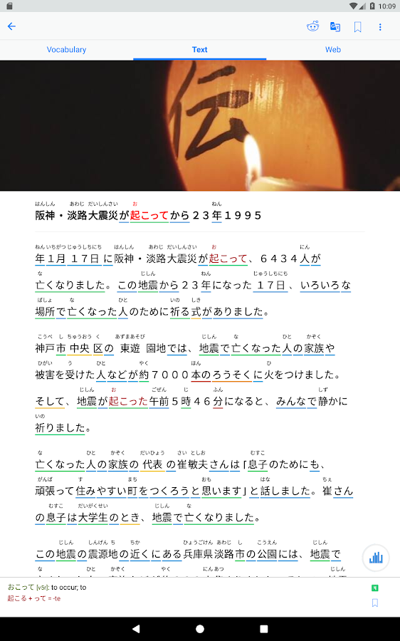
TangoRisto app
Selects news articles from several sources on the web
Categorises words by function and form
Touch to select for definition/pronunciation
Facilitates quick understanding and rewarding access to Japanese sources which are brand new – understanding the real world
Automatically creates a full set of flashcards – incredibly efficient

Slide 7
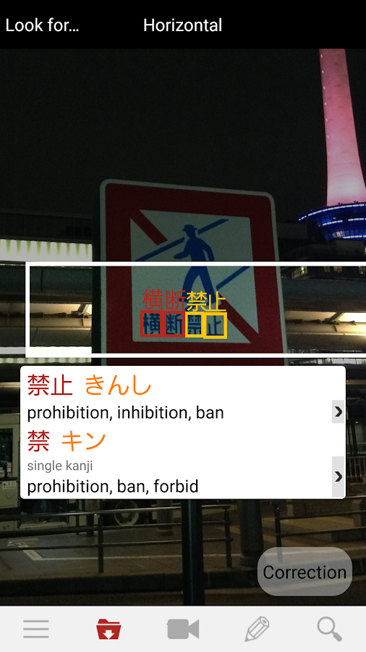
Yomiwa – internet 3.0?
Pay app
Uses augmented reality to read text in the world around you
Can add to vocab list or kanji list for review
Extraordinary
But
Shaky and somewhat difficult to interact with
…at the moment

