Slide 1
Using OneDrive with Students
Jenna Bodin-Galvez and Jane templeton

Slide 2
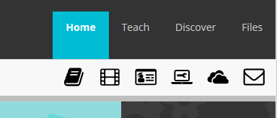
Accessing OneDrive

Slide 3
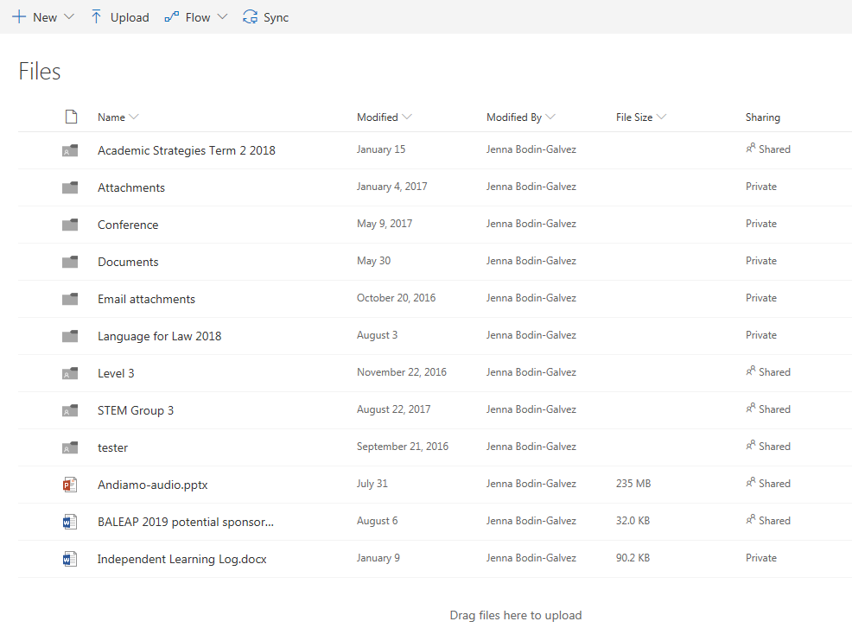

Slide 4
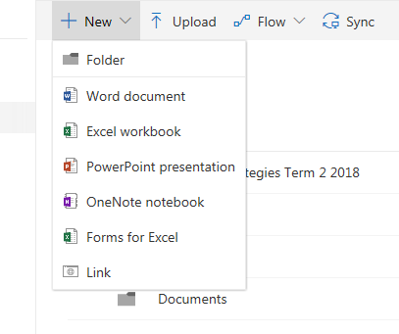
Creating/uploading documents

Slide 5
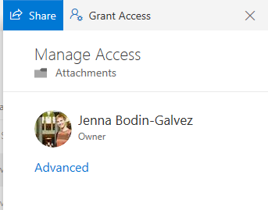
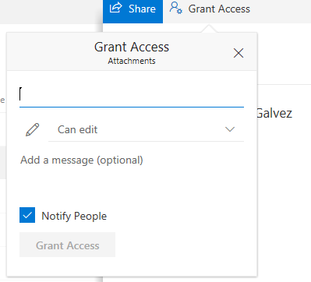
Sharing Documents

Slide 6
My Main Uses
Working collaboratively on documents
Sharing documents
Becoming paperless

Slide 7
1. Working collaboratively on documents
Examples of collaborative work:-
Language for Law phrasebank
Summarising sources in class
Group report writing

Slide 8
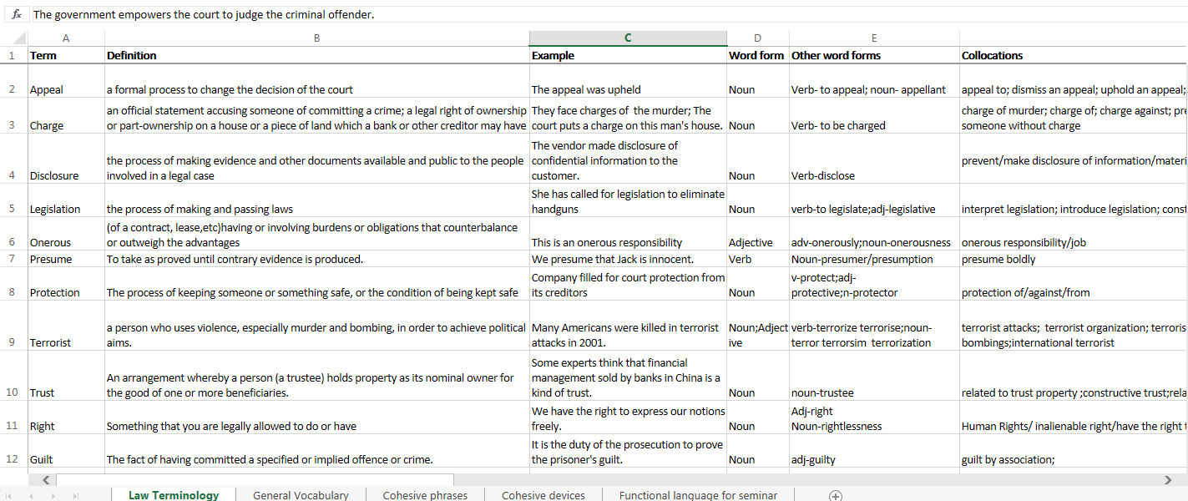
Language for Law Phrasebank

Slide 9
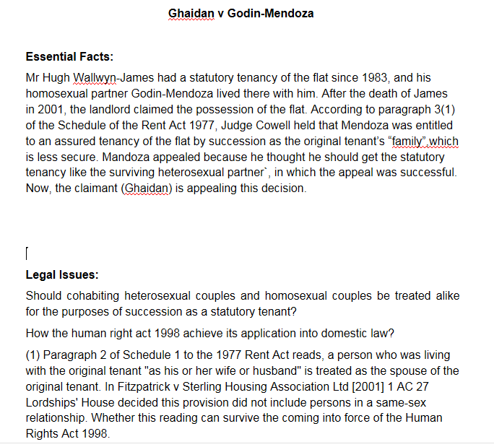
Collaborative summary

Slide 10
Benefits of using OneDrive in class
Students can all work on the same document at the same time
Easy to monitor
Students have a copy of the work others have done
As long as they have this email account, they have access to the document
Trains them in using OneDrive- group work is central to many academic courses

Slide 11
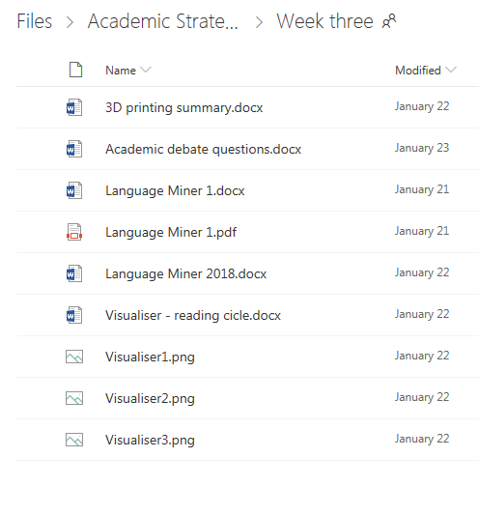
Sharing Documents
Example: Students sharing- Academic Strategies work
Students shared
all work they had done
with each other
Got full understanding
of the article and had
continuous access to
documents

Slide 12
Example: Independent learning logs
for consultations
Students added to logs each week
I could check and comment on actions/progress in advance of the consultation= time used more efficiently in consultation

