Slide 1
Using Desktop Capture for Audio-visual Feedback
LCS DIGITAL LEARNING SHOWCASING
School of Languages, Cultures and Societies
7 November 2018
Antonio Martínez-Arboleda
Teaching Enhancement Project Leader

Slide 2
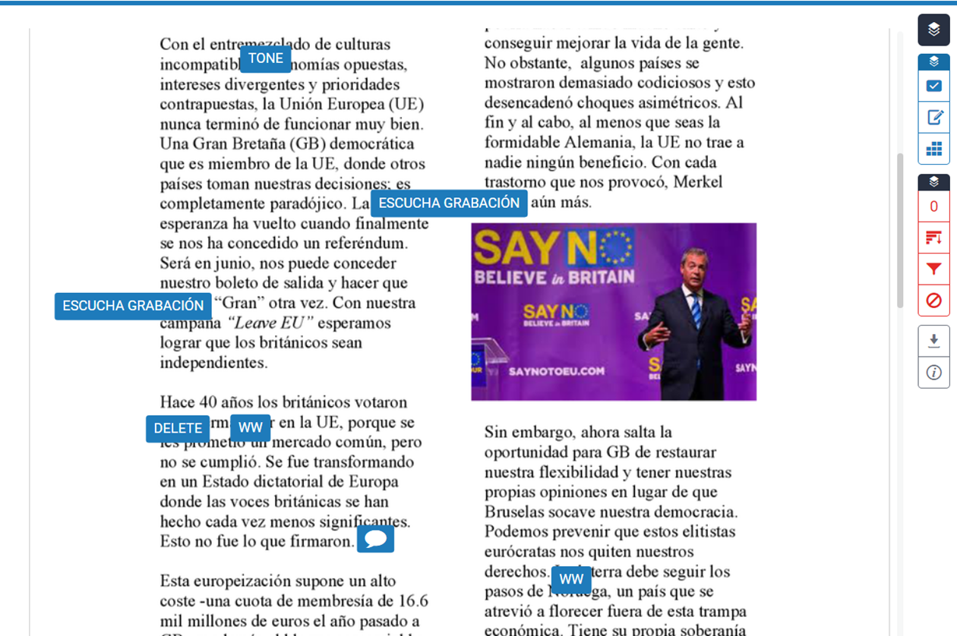
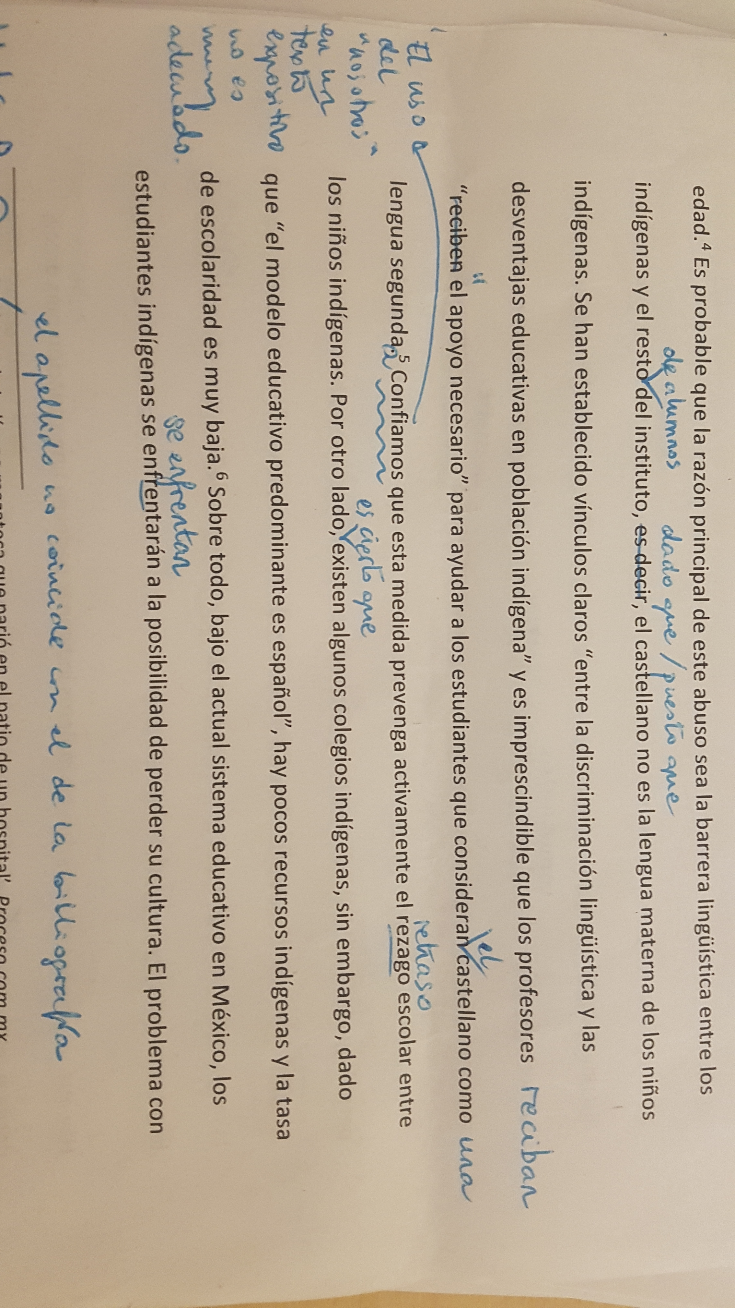

Slide 3
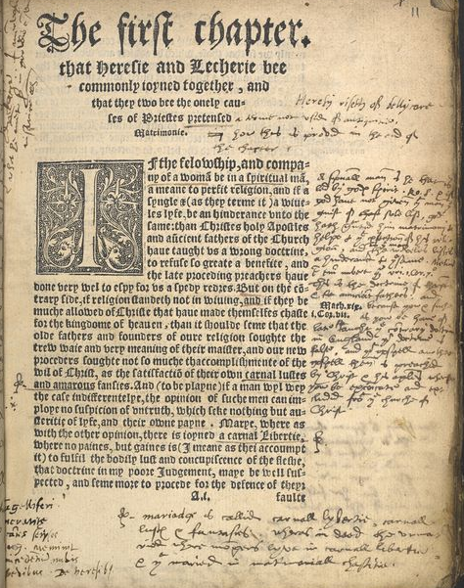

Slide 5
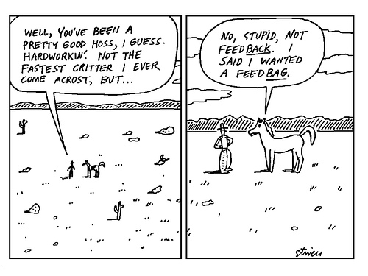

Slide 6
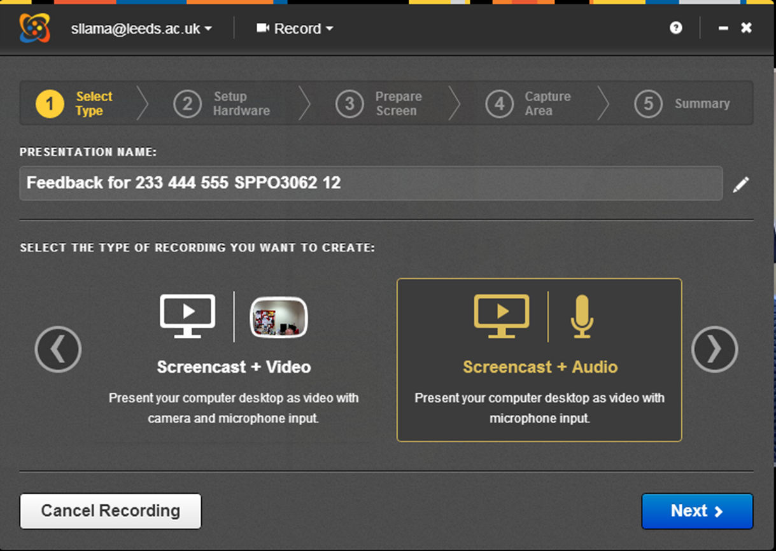
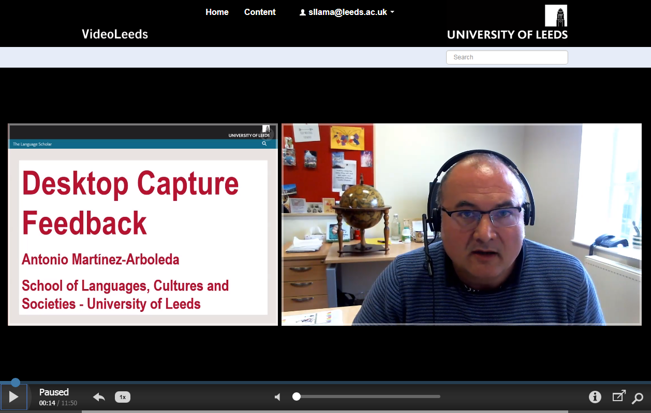
Content slide

Slide 7
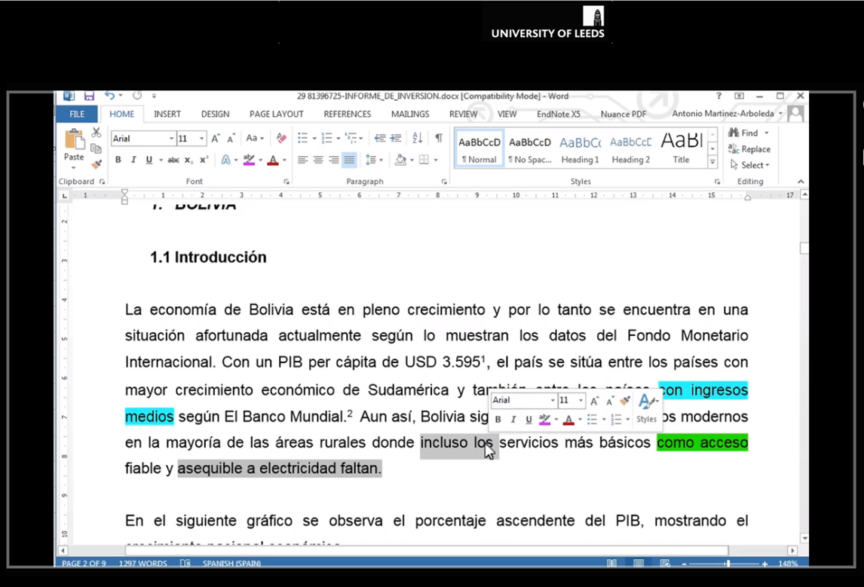
Content slide

Slide 8
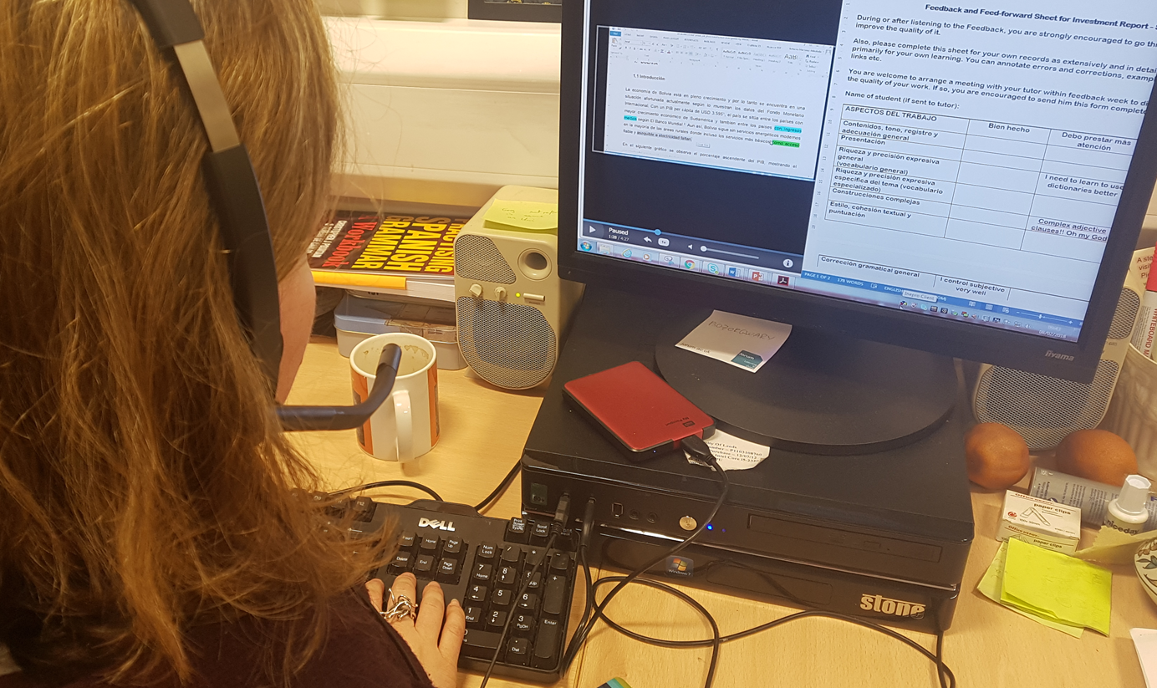

Slide 9
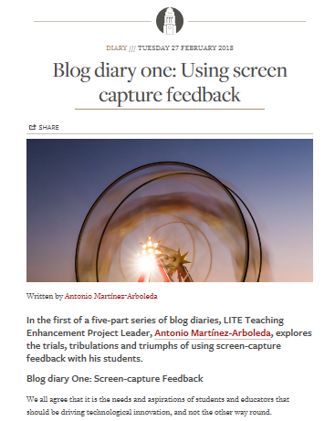
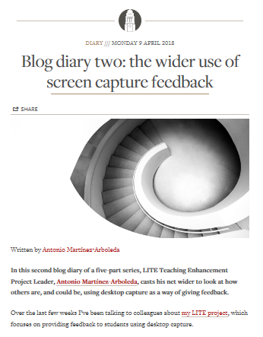
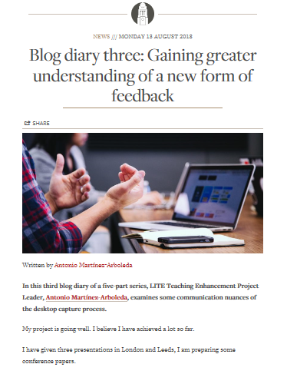

Slide 10
Project Outputs
A report with findings and recommendations for the provision of feedback on written assessment for the whole of our institution and beyond;
A range of robust yet customisable user journeys for
the production, accessible storage and sharing of screencasts
the consumption and acting upon the feedback by the students;
the administrative handling of documentation on feedback respecting QA principles and policies.
A comprehensive guide to facilitate training of colleagues in the use of the proposed method.
Tutors will start doing it anyway. We have duty to the students: providing the best.

Slide 11
Other issues
Looking at practicalities: platform integration - storage
Ideal contexts: perhaps non-high stakes, not anonymous
Educational reflection and design for better tools
and for more informed, responsible and critical use of technology.

Slide 12
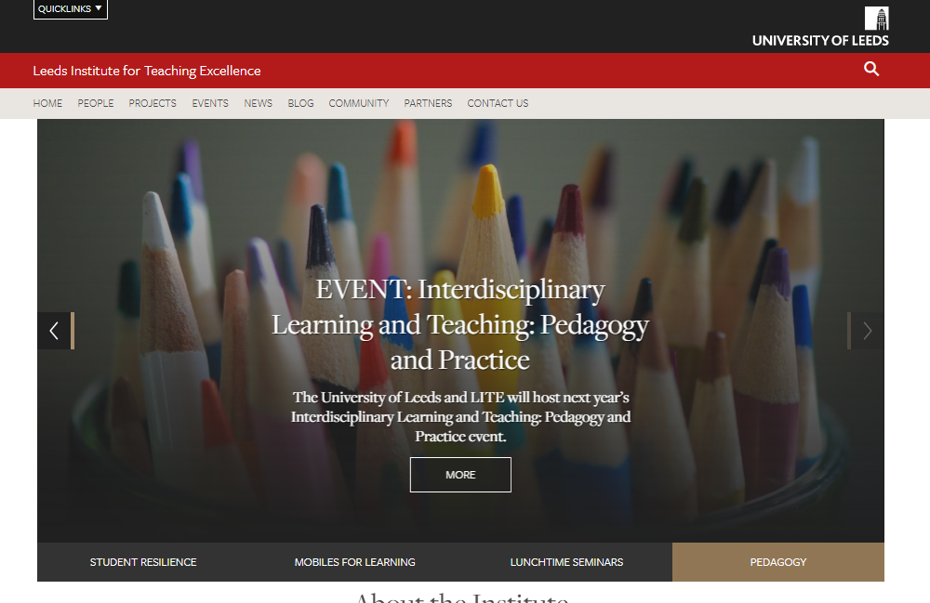
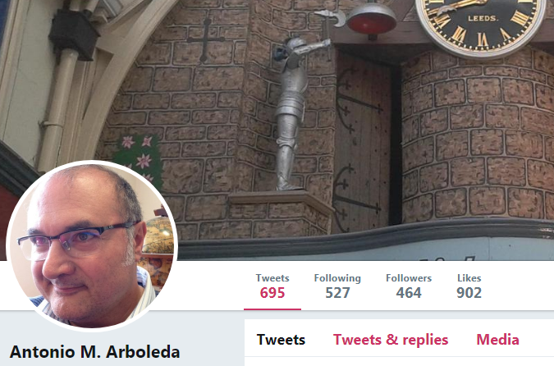
http://teachingexcellence.leeds.ac.uk/
#audiovisualfeedback

Slide 15
Breaking Boundaries: The distinctiveness of Screencast Feedback:
1. A collaborative or choral form of text
The written text of the student, an essay, for instance
His writing with references to the ideas of other authors, direct or mediated
The text of the tutor
Her comments on the text of the student, including on the ideas of others introduced by the student

Slide 16
Breaking Boundaries: The distinctiveness of Screencast Feedback:
2. A much more multimodal form of text
The written text of the student
The texts of the tutor in different modes
Her voice, her writing, the writing of others, images, graphs
and the blending element:
Deixis: Linguistic (words) and visual (pointing, highlighting, colouring)…

Slide 17
Breaking Boundaries: The distinctiveness of Screencast Feedback:
3. A catalyst for Critical Review:
Of our own assessment criteria:
The medium matters, are we missing emerging criteria?
Deeper cognitive engagement
The types of tasks
New tasks like blogs, web pages, with more visual content

Slide 18
Breaking Boundaries: The distinctiveness of Screencast Feedback:
4. A genre in the making:
Remediation
Gains and loses: Release ballast
Take advantage creatively of the wider range of communicative opportunities: specific individual analysis on a case by case basis.
Exercise pedagogical judgement. The tutor as designer: agency

Slide 19
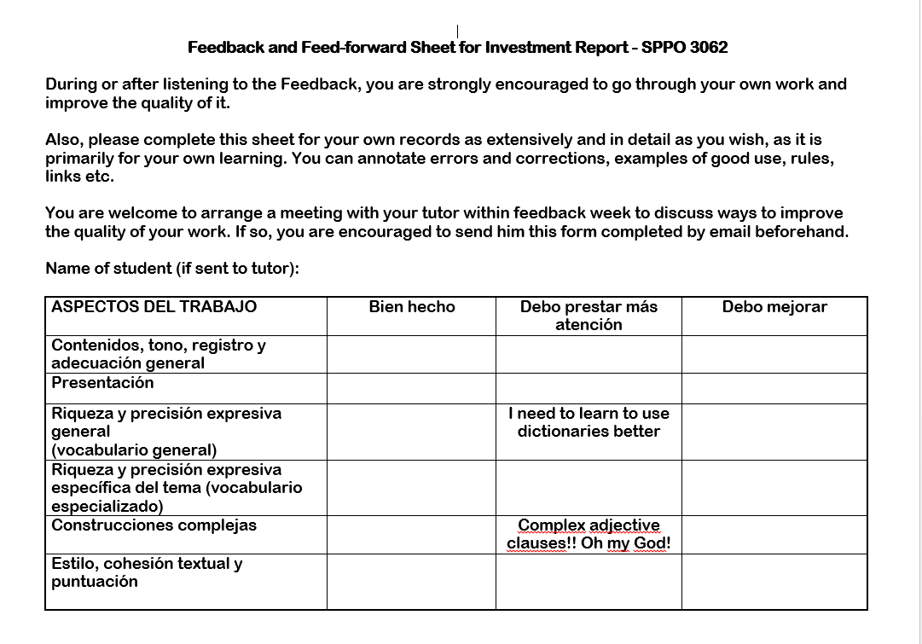
Grading
Feedback

Slide 20
Granular
Summative
Live
Staged
EACH TASK IS DIFFERENT
Stand alone
Accessory
Dialogic
Monologic
Reasoned
Authoritative
EACH SUBJECT IS DIFFERENT
Visually Deictic
Audio Deictic
Teaching-focused
Grading-focused

Slide 22
Audio-visual Feedback: Back to Future?
LCS DIGITAL LEARNING SHOWCASING
THANK YOU
Antonio Martínez-Arboleda
Teaching Enhancement Project Leader

Slide 23
Like any other form of multimodal expression, audio-visual feedback provides and opportunity to create new itineraries for “nesting”, the ability to embed past and future thoughts, whether your own or someone else’s, in one’s thinking at a given time.

Slide 24
For Michael Corballis this human capacity, called “recursive thought”, is what differentiate us from animals. Audio-visual feedback is a particularly challenging context for the examination of nesting, as in many cases Surely, a wise combination of voice, the pointing, highlighting of student text, and the showing of other’s texts can make the nesting process more agile, narratively, and more accessible for the student, allowing both greater depth and clarity from the tutor.

