Slide 1
Feedback at scale
Joanne Shiel
Director of Year 1
South-West Jiaotong-Leeds Joint School
Faculty of Engineering
j.r.shiel@leeds.ac.uk

Slide 2
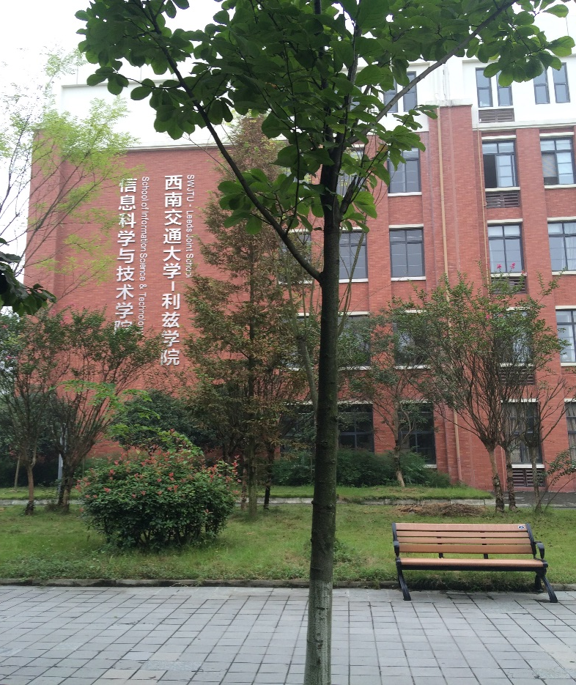
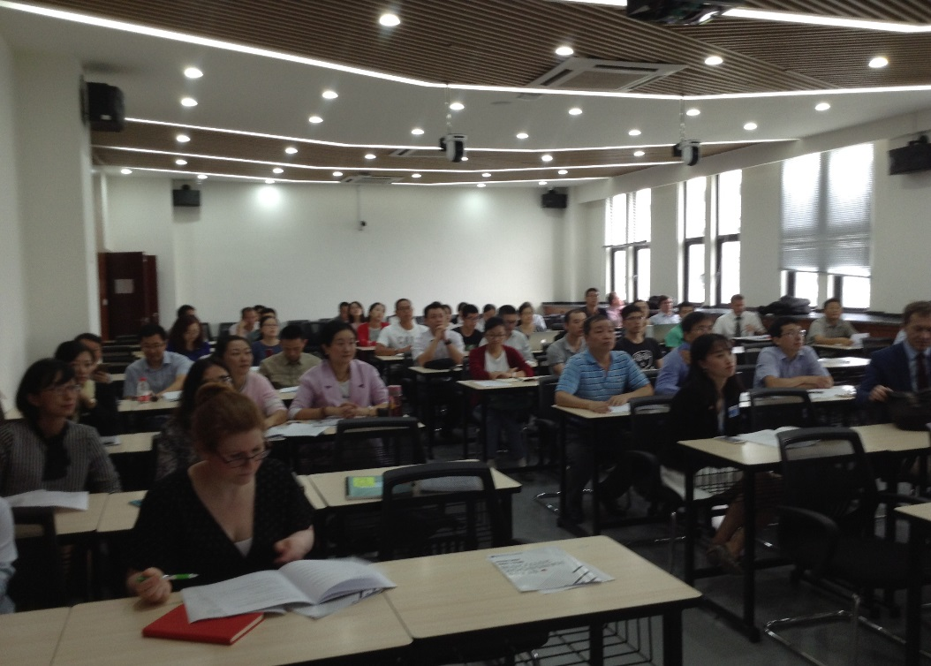
Situation
Compulsory 60 credit module 286 students

Slide 3
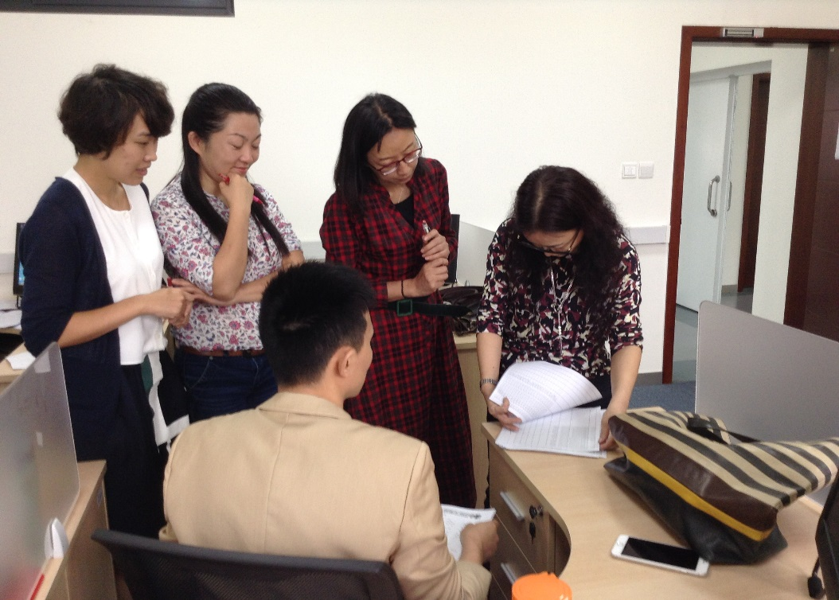
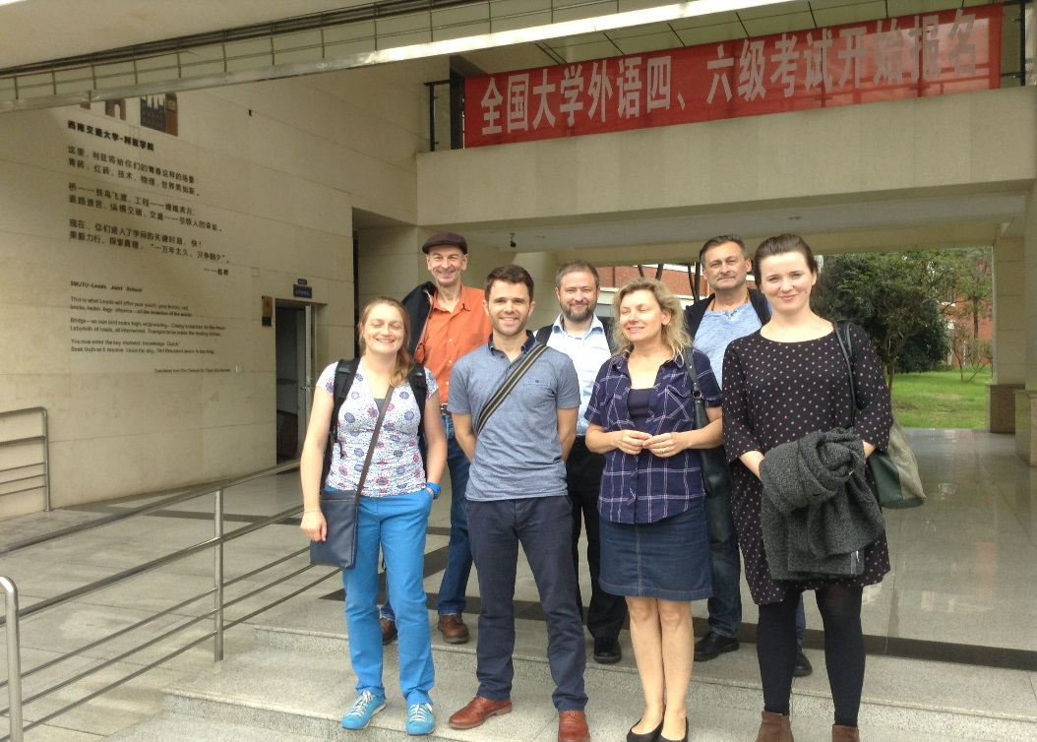
Semester 1 – 14 staff Semester 2 – 8 staff
Situation
Physics – 286 students – 1 member of staff

Slide 4
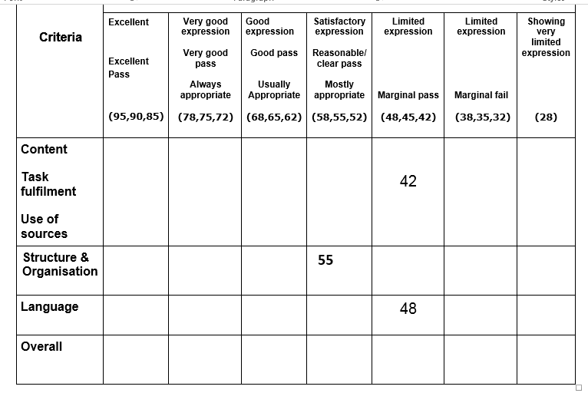
Problem – the scale

Slide 5
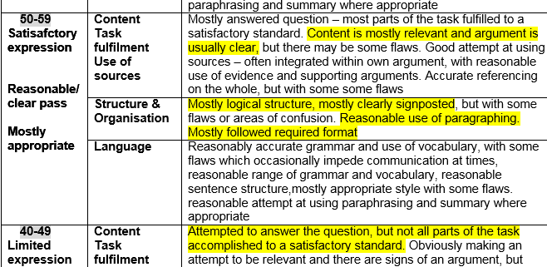
Problem – the scale

Slide 6
Problem – the scale
1 Physics teacher, 300 lab reports:
How do you want me to give each student feedback?
English teacher
How can I give feedback to 40 students?

Slide 7
Problem – the distance
Module leader
How can I see/know what everyone is doing?
Two teaching teams
Where can we store the feedback?
External examiner
How can I see what feedback has been given to students?

Slide 8
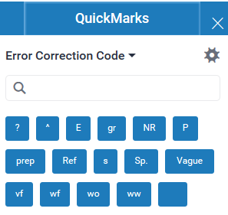
Aim

Slide 9
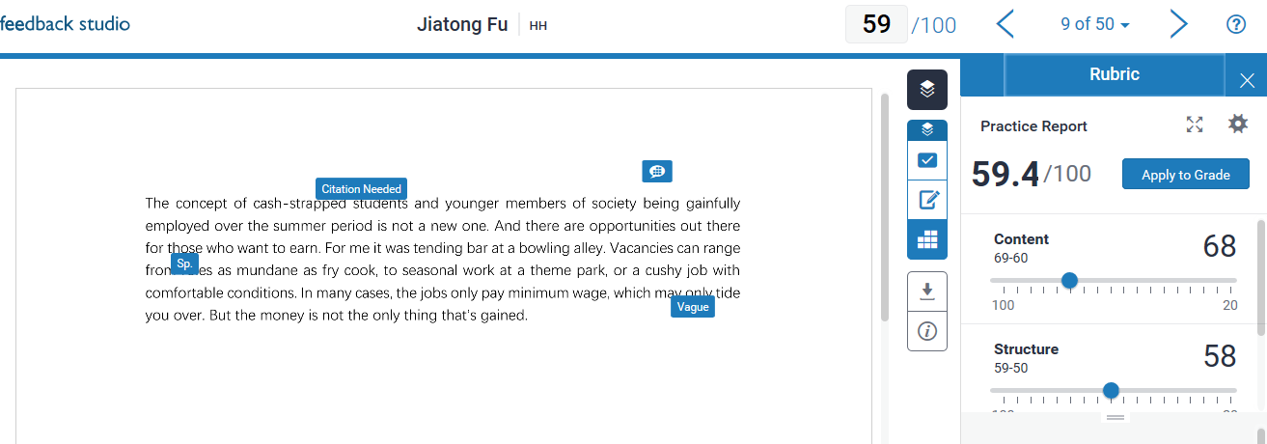
Aim

Slide 10
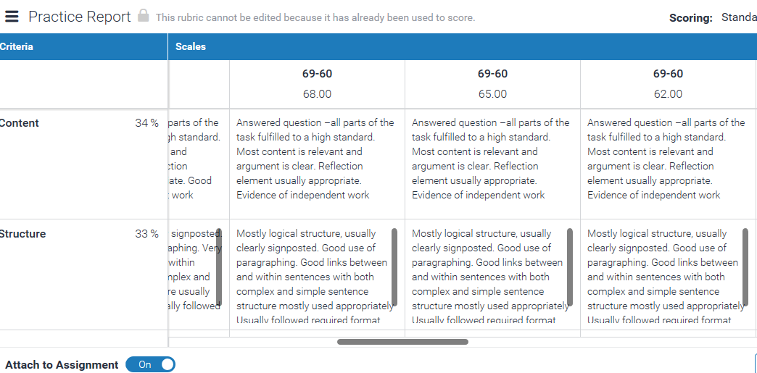
Aim

Slide 11
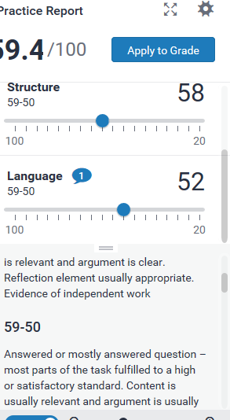
Aim

Slide 12
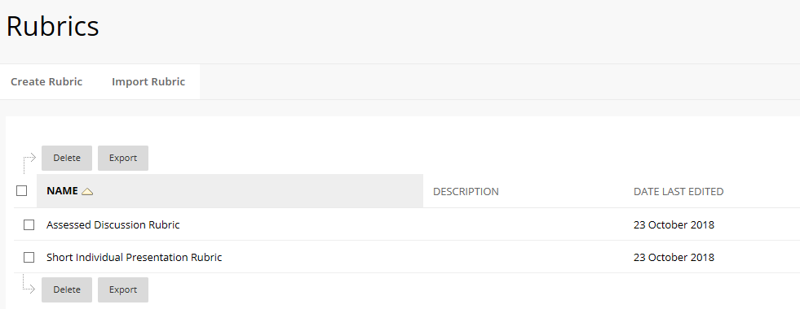
Situation

Slide 13
Situation
Blackboard Rubric
Presentations

Slide 14
Aim

Slide 15
Aim
Making marking:
More efficient
More visible
More accountable
Making feedback
possible

Slide 16
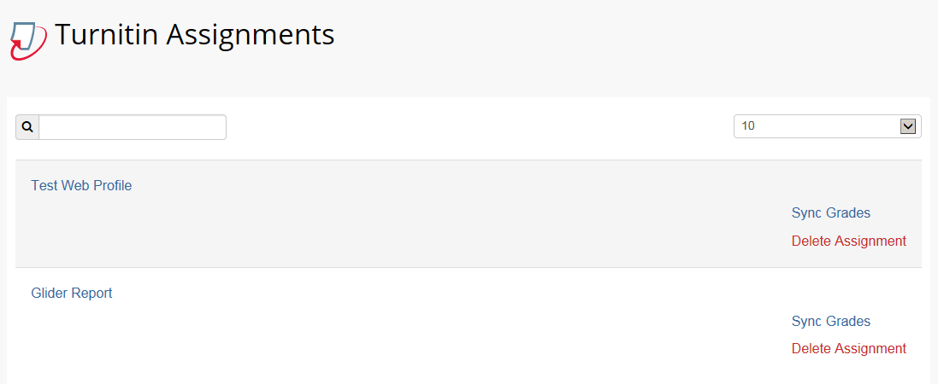
Solution
Turnitin rubrics

